Slide 1
Fundamental Cloud Concepts for AWS
UNDERSTANDING CLOUD COMPUTING

Slide 2
Setting Up an AWS Account

Slide 3
Demo
Creating a new personal AWS account Activating the new account
Configuring a budget alert for the account

Slide 5
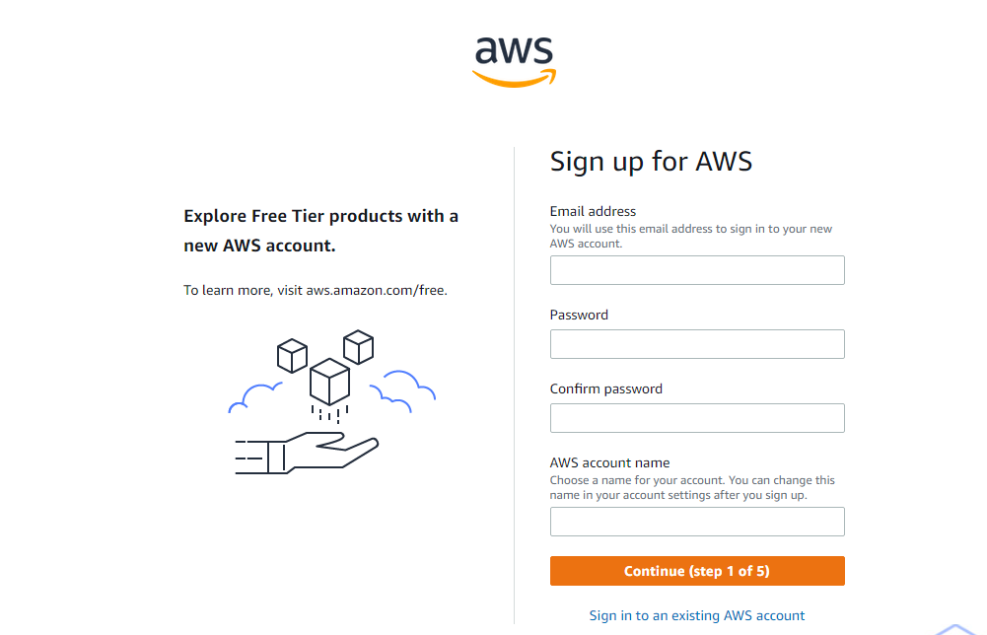

Slide 6
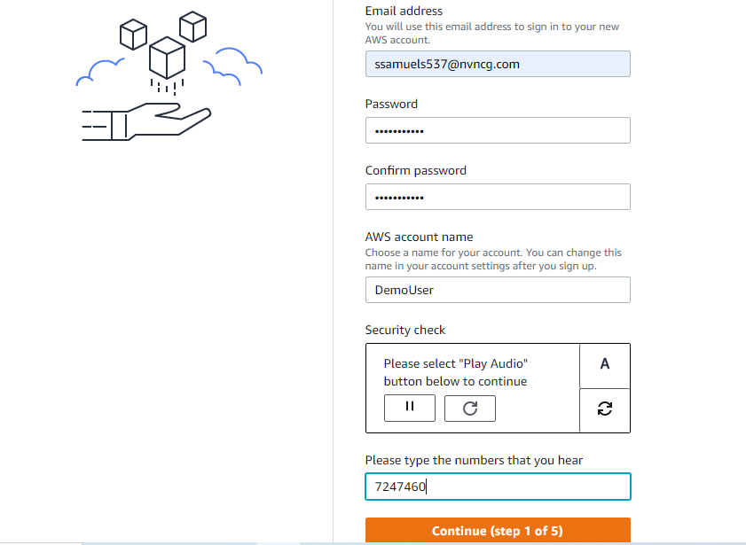

Slide 7
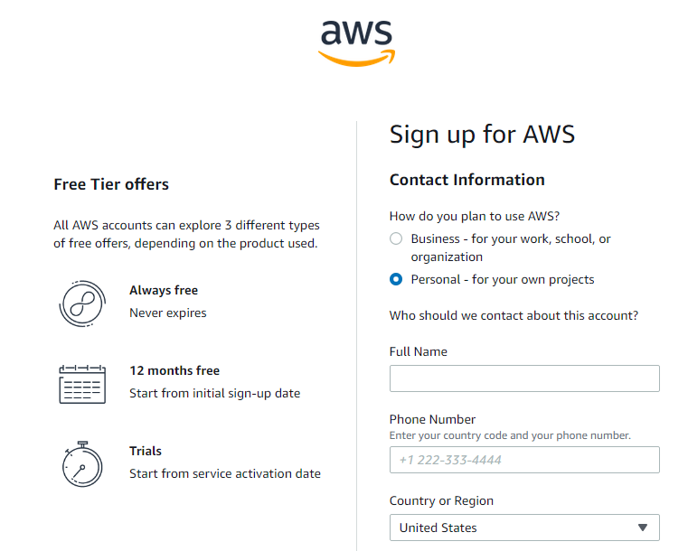
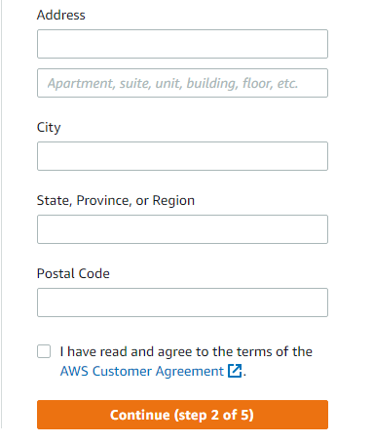

Slide 8
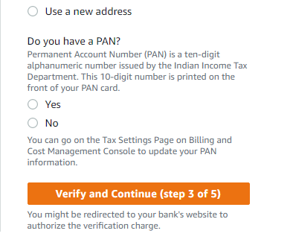

Slide 10
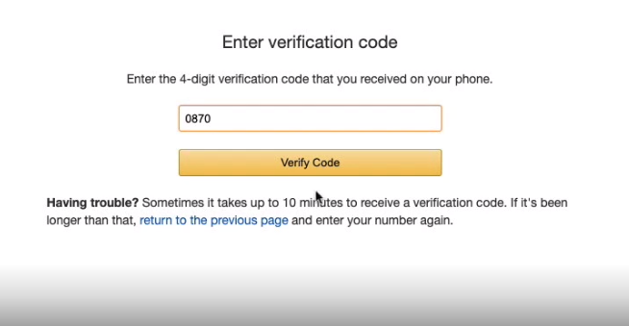

Slide 11
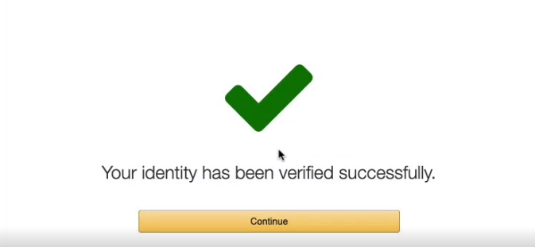

Slide 12
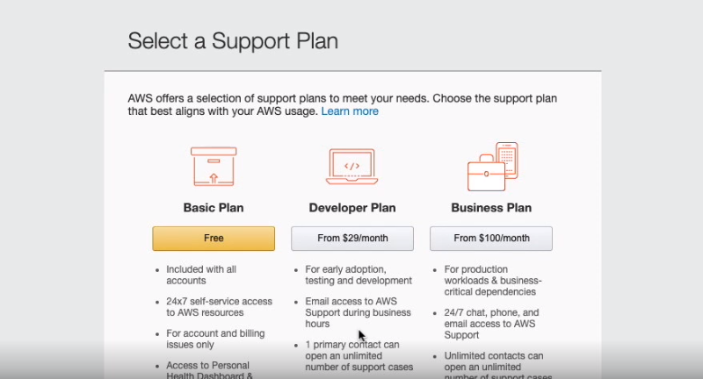

Slide 13
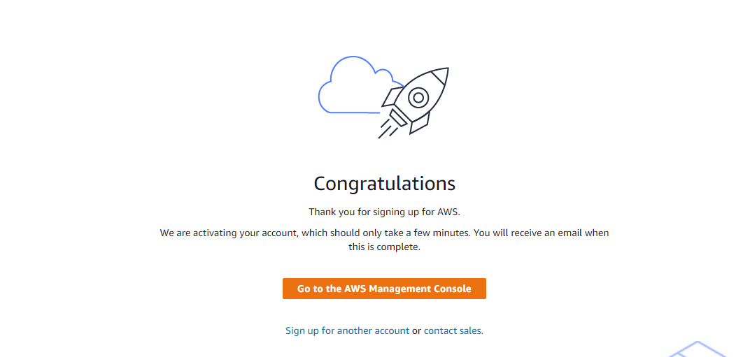

Slide 14
Traditional Data Centers

Slide 15

Globomantics Social Network
Launching a new social network for professionals
Focusing on the United States at launch
Looking to expand into Europe and Asia if launch is successful
Securing funding for the initial infrastructure

Slide 16



Social Network Data Centers
Data Center
Data Center
Data Center
Dublin, Ireland
Nashville, TN
Singapore
Dublin, Ireland
Nashville, TN

Slide 17
Large up-front investment Forecasting demand is
difficult
Slow to deploy new data centers and servers
Maintaining data centers
is expensive
You own all of the security and compliance burden
Traditional Data Centers

Slide 18
Benefits of Cloud Computing

Slide 19
Trade capital expense for variable expenses
Benefit from massive economies of scale
Stop guessing capacity Increase speed and agility
Stop spending money maintaining data centers
Go global in minutes
Advantages of Cloud Computing

Slide 20
“Elasticity is the ability to acquire resources as you need them and release resources when you no longer need them. In the cloud, you want to do this automatically. ”
Well-Architected Framework, Amazon Web Services

Slide 21
Reliability
A solution’s ability to provide functionality for its users when it is needed. Amazon’s global infrastructure is built to maximize reliability for your cloud workloads.

Slide 22
The cloud lowers the cost of trying new ideas or business processes
Reduces the time required to maintain infrastructure
Reduces risk for the organization around security and compliance
Provides access to emerging technologies
Agility

Slide 23
Types of Cloud Computing

Slide 24
“Cloud computing is the on-demand delivery of compute power, database storage, applications, and other IT resources through a cloud services platform via the Internet with pay-as- you-go pricing.”
Amazon Web Services

Slide 25
Cloud Computing Models
Infrastructure as a Service (IaaS)
Platform as a Service (PaaS)
Software as a Service (SaaS)
Maximum Control
Minimum
Maintenance

Slide 26
Cloud Deployment Models
Public Cloud
Deployed onto a public cloud provider like AWS
On-Premises (Private Cloud)
Cloud-like platform in a private data center
Hybrid
Cloud applications connected to a private data center

Slide 27
Cloud Computing Scenarios

Slide 28

Scenario 1
Roger’s company runs several production workloads in its data center
They are using VMWare to manage infrastructure in their data center
They want to use AWS and integrate it with their data center for new workloads
Which cloud deployment model would his company be following?

Slide 29

Scenario 2
Eliza’s company is trying to decide whether to fund a new line of business
Eliza’s team is looking to monetize a new emerging technology
This new line of business will require new infrastructure
What benefit of cloud computing would be most relevant to her company?

Slide 30

Scenario 3
Jennifer is the CTO at an insurance company
They are considering moving to the cloud instead of colocating servers
They want to make sure they have maximum control of the cloud servers
Which cloud computing model would they need to leverage?

Slide 31
Summary

Slide 32

Created an AWS account for personal use
Examined how organizations leverage traditional data centers
Explored the benefits of cloud computing
Reviewed cloud computing models
Understood cloud computing deployment models
Summary

Slide 33
Scenario 1
Roger’s company runs several production workloads in its data center
They are using VMWare to have cloud- like infrastructure in their data center
They want to use AWS and integrate it with their data center for new workloads
Which cloud deployment model would his company be following?
Solution: Hybrid Cloud

Slide 34
Scenario 2
Eliza’s company is trying to decide whether to fund a new line of business
Eliza’s team is looking to monetize a new emerging technology
This new line of business will require new infrastructure
What benefit of cloud computing would be most relevant to her company?
Solution: Pay as you go

Slide 35
Scenario 3
Jennifer is the CTO at an insurance company
They are considering moving to the cloud instead of colocating servers
They want to make sure they have maximum control of the cloud servers
Which cloud computing model would they need to leverage?
Solution: Infrastructure as a Service (IaaS)

